Slide 1
Curiosity and wonder in geography
Core units: Key understandings Years 5–6
Illustration 1: Pointers to understanding

Slide 2
What are the rationale and aims of the geography curriculum? How can a primary teacher create curiosity and wonder?

Slide 3
Rationale and aims of Australian Curriculum: Geography
Rationale - A study of geography develops students’ curiosity and wonder about the diversity of the world’s places, peoples, cultures and environments
Aims – Develop a sense of wonder and curiosity and respect about places, people, cultures and environments throughout the world

Slide 4
Good teaching
Start with the child’s interests and knowledge … BUT don’t stop there!
Expand, extend, deepen
Use your own excitement and ‘sense of wonder and curiosity’ to excite students
Use other students’ curiosity to stimulate more students

Slide 5
What are your interests, ‘wonders and curiosities’?
Maps?
Travel?
Reading?
Bushwalking?
Photography?
Gardening?
Weather?
Animals and plants?
Conservation?
Influencing the local area?
Other cultures?
Interesting people and places?
Environmental issues?

Slide 6
Using your enthusiasms
Think about your enthusiasms that relate to geography
Open the eyes of students to these
Let students try them, if appropriate

Slide 7
Enjoyment
Enjoyment is the birthright of every child
Geography allows this to happen through rich and diverse subject matter, and active participation in enquiry approach
Geography teaching must inform, stimulate and motivate students

Slide 8
Enjoyment can be increased by…
Active participation
Stimulating curiosity
Showing wonders of the world
Encouraging emotional responses as well as cognitive understanding

Slide 9
What are some indications that we are achieving ‘wonder and curiosity’?
WoW! emotional reaction from a student as they get excited about this ‘World of Wonder!’
Students find out information and want to share it
Students show they are fascinated by particular places in the world
Students respond to our enthusiasms, and develop their own

Slide 10
Some techniques to encourage ‘wonder and curiosity’
Use maps of all kinds
Use the outdoor local area
Use the enquiry approach to stimulate thinking
Encourage emotions, opinions, points of view
Use vivid photographs
Use IT for vivid virtual experiences
Use selected excerpts of videos

Slide 11
More techniques to encourage ‘wonder and curiosity’
Use mental maps to involve students personally
Use thinking activities such as ‘geographical mysteries’
Use GPS devices for outside fieldwork

Slide 12
Photography
Not just taking photographs – but photographing geographically !
Look for geographical characteristics
Look for contrasts and juxtapositions
Look for stories that the photo can tell
Be careful with framing to emphasise the point

Slide 13
Framing a photograph demolition and development

Slide 14
Telling a story providing power to fast developing cities

Slide 15
Reading
Travel books
Fiction set in well researched locations
Fact-based stories of geography
‘Horrible Geography’ series

Slide 16
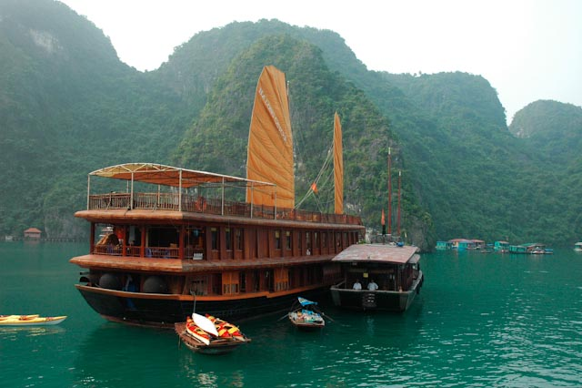
The excitement of far-off places

Slide 17
The influence of other places on our place

Slide 18
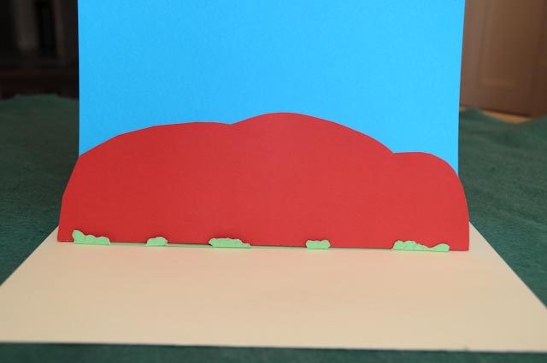
Making simple models
A pop-up model of Uluru

Slide 19
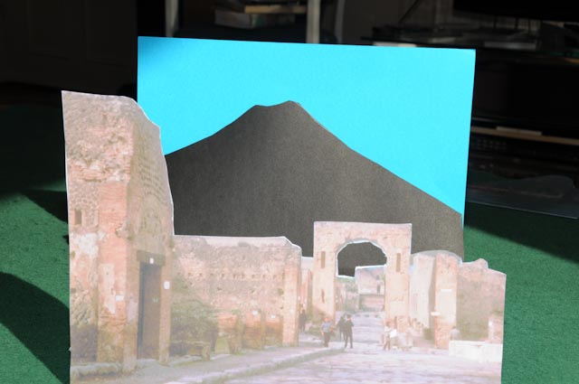
Making simple models
A simple model of Pompeii and Vesuvius

Slide 20
ITC some examples of key resources to stimulate geographers
Google Earth
nearmap – dated aerial photographs of your local area
Worldmapper – website
Gapminder – website
GIS – adding layers to customise maps

